Slide 1
Introduction to
Machine Learning
Instructor: Dr. Jeff Fortuna, B. Eng, M. Eng, PhD, (Electrical Engineering), McMaster University
email: fortunjj@mcmaster.ca

Slide 2

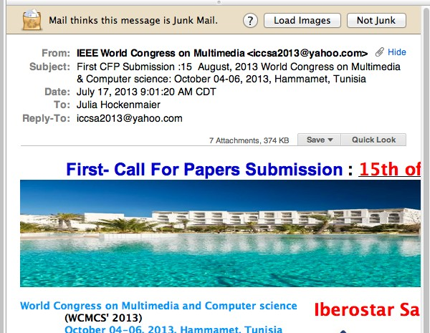
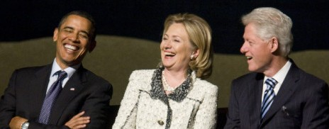

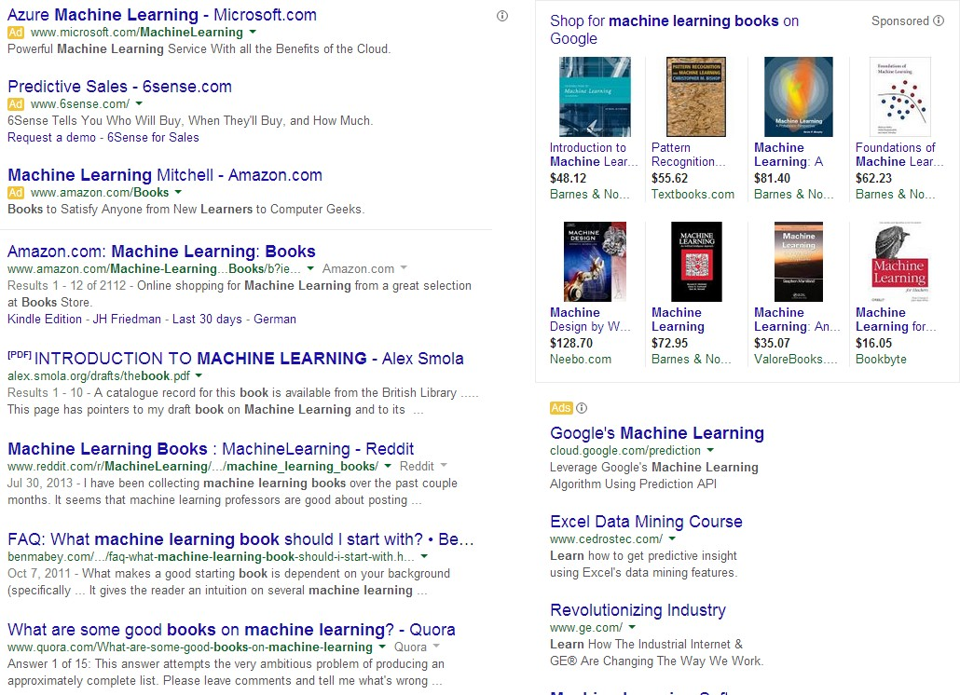

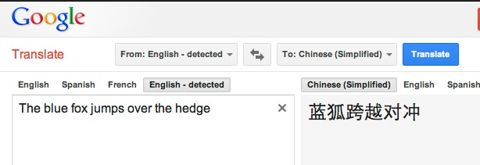
Machine Learning is Everywhere
2

Slide 3

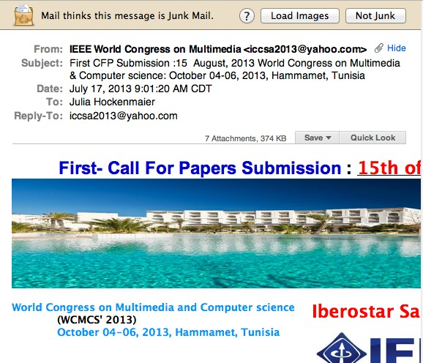




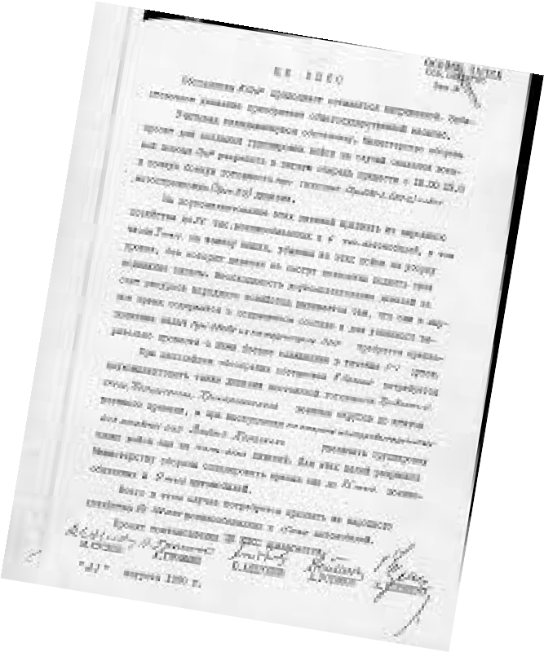










Applications: Spam Detection
This is a binary classification task: Assign one of two labels (i.e. yes/no) to the input (here, an email message)
Classification requires a model (a classifier) to determine which label to assign to items.
Data Documents Sentences Phrases Images
Labels
Politics, Sports, Finance Positive, Negative
Person, Location cats, dogs, snakes
?
Medical records Re-admit soon/Not
…..
3

Slide 4
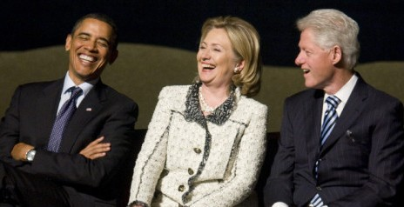
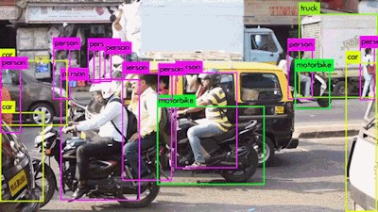
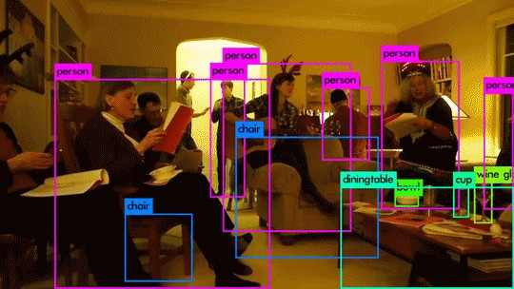
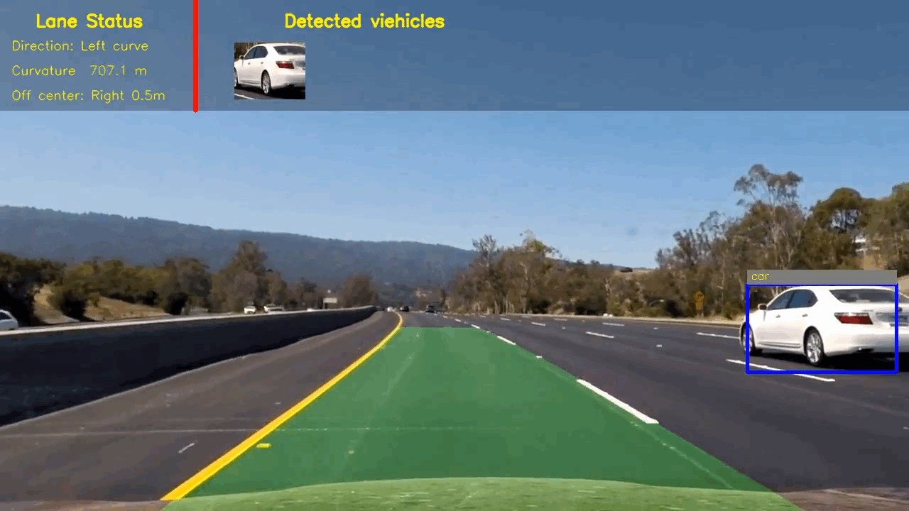
Applications: Object Recognition
Image credits: http://prostheticknowledge.tumblr.com/post/172309765681/yolo-v3new-release-of-object-recognition-framework https://junshengfu.github.io/vehicle-detection/
4

Slide 5
What is Machine Learning?
“Learning is any process by which a system improves performance from experience.”
- Herbert Simon
Definition by Tom Mitchell (1998):
Machine Learning is the study of algorithms that
improve their performance P
at some task T
with experience E.
A well-defined learning task is given by <P, T, E>.
5

Slide 6
Traditional Programming
Data Program
Computer
Output
Machine Learning
Data Output
Computer
Program
Slide credit: Pedro Domingos
6

Slide 7
Why Study/Use Machine Learning?
“A breakthrough in machine learning would be worth ten Microsofts”
-Bill Gates, Chairman, Microsoft
“Machine learning is the next Internet”
-Tony Tether, Director, DARPA
Machine learning is the hot new thing”
-John Hennessy, President, Stanford
“Web rankings today are mostly a matter of machine learning”
-Prabhakar Raghavan, Dir. Research, Yahoo
“Machine learning is going to result in a real revolution”
-Greg Papadopoulos, CTO, Sun
“Machine learning is today’s discontinuity”
-Jerry Yang, CEO, Yahoo
Based on slide by Pedro Domingos
7

Slide 8
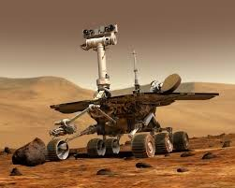
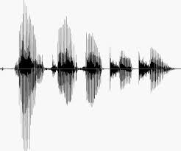
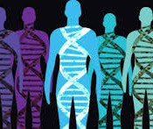
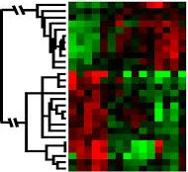
When Do We Use Machine Learning?
ML is used when:
Human expertise does not exist (navigating on Mars)
Humans can’t explain their expertise (speech recognition)
Models must be customized (personalized medicine)
Models are based on huge amounts of data (genomics)
Learning isn’t always useful:
There is no need to “learn” to calculate payroll
Based on slide by E. Alpaydin
8

Slide 9
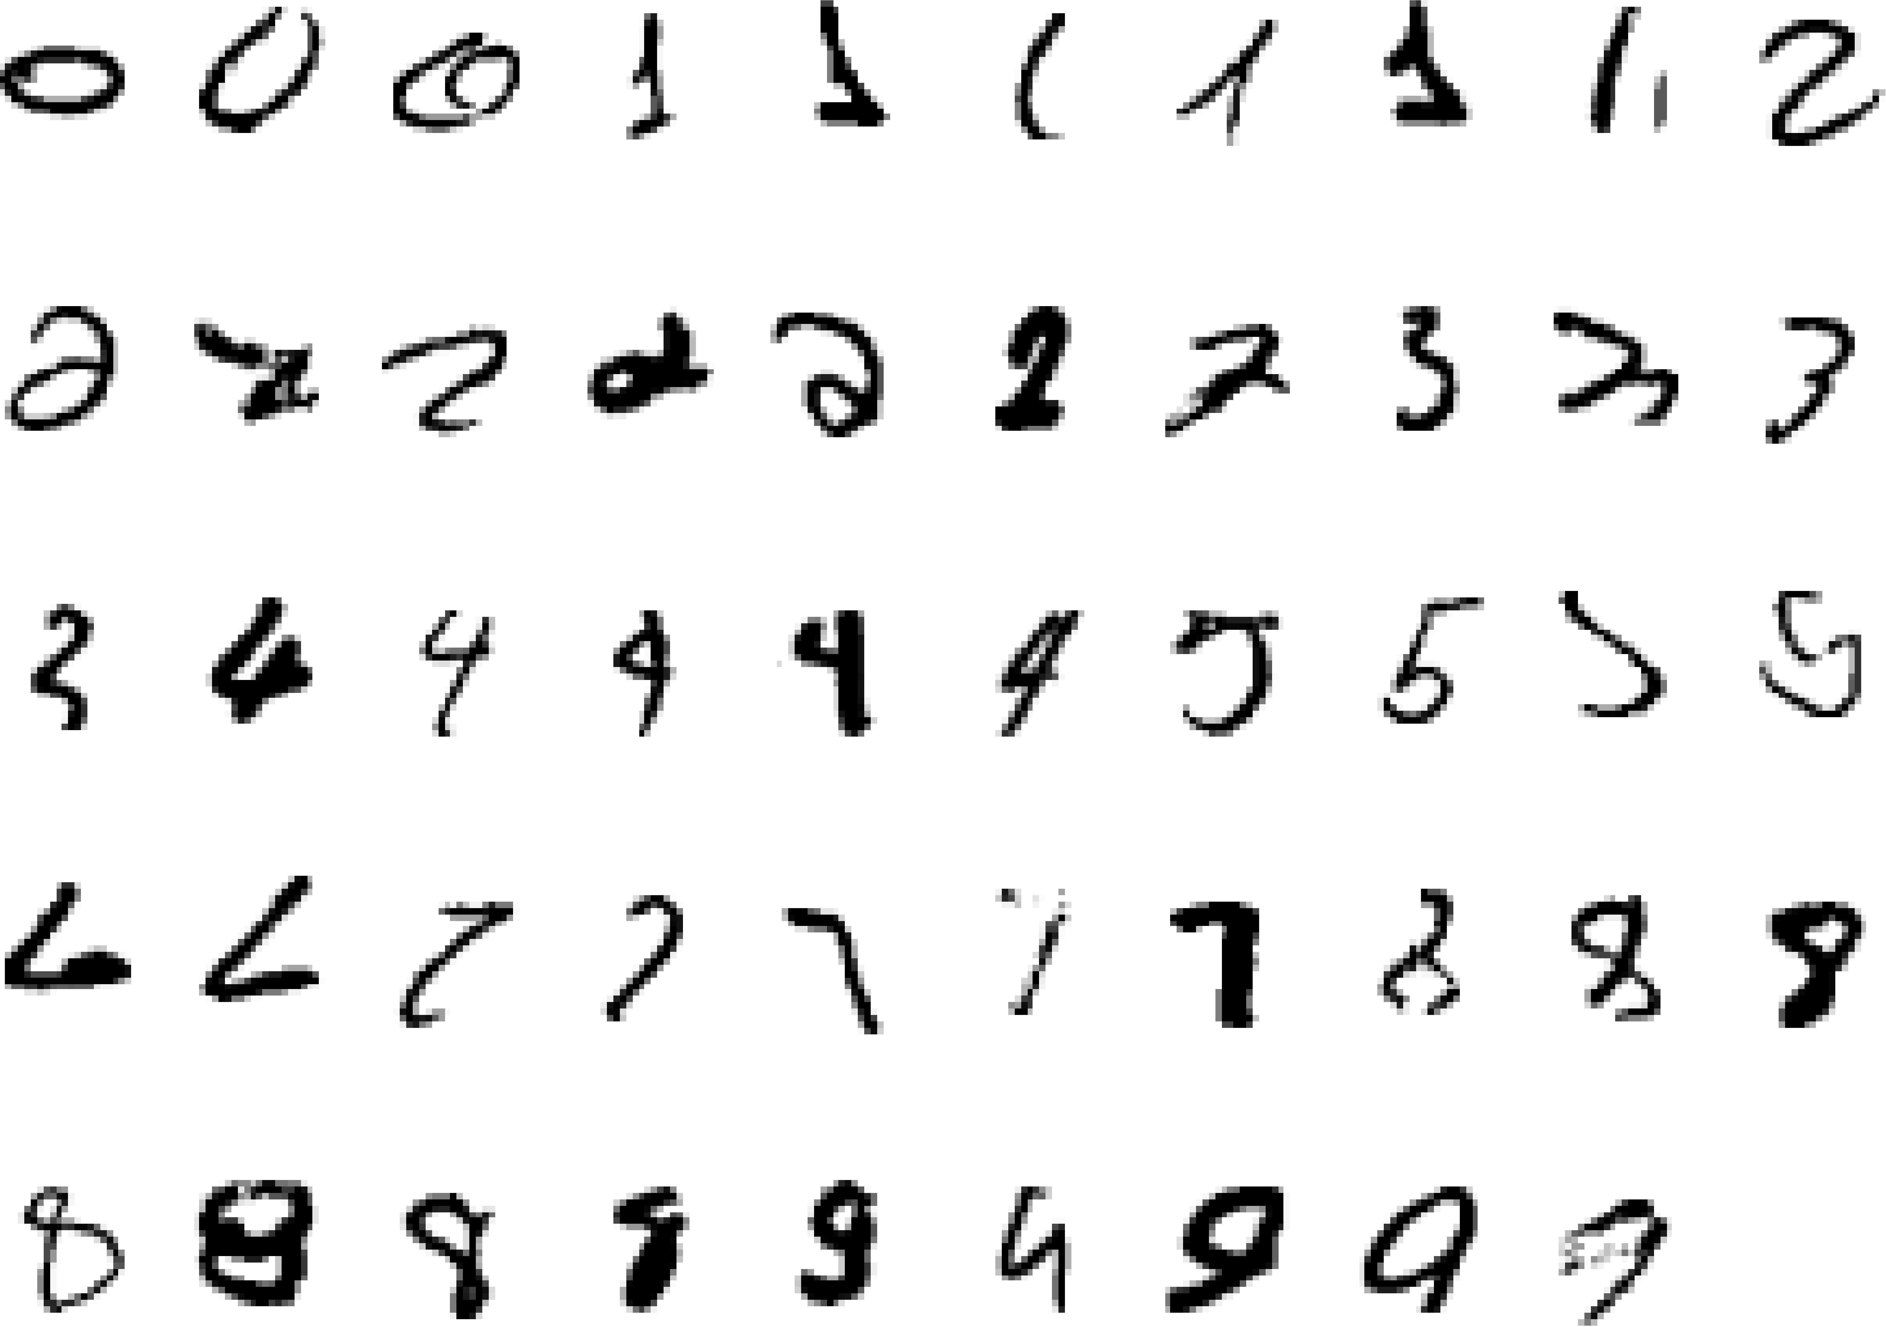
A classic example of a task that requires machine learning: It is very hard to say what makes a 2
Slide credit: Geoffrey Hinton
9

Slide 10
Learning = Generalization
H. Simon -
“Learning denotes changes in the system that are adaptive in the sense that they enable the system to do the task or tasks drawn from the same population more efficiently and more effectively the next time.”
The ability to perform a task in a situation which has never been encountered before
10

Slide 11
Some more examples of tasks that are best solved by using a learning algorithm
Recognizing patterns:
  Facial identities or facial expressions
  Handwritten or spoken words
  Medical images
Generating patterns:
  Generating images or motion sequences
Recognizing anomalies:
  Unusual credit card transactions
  Unusual patterns of sensor readings in a nuclear power plant
Prediction:
  Future stock prices or currency exchange rates
11
Slide credit: Geoffrey Hinton

Slide 12
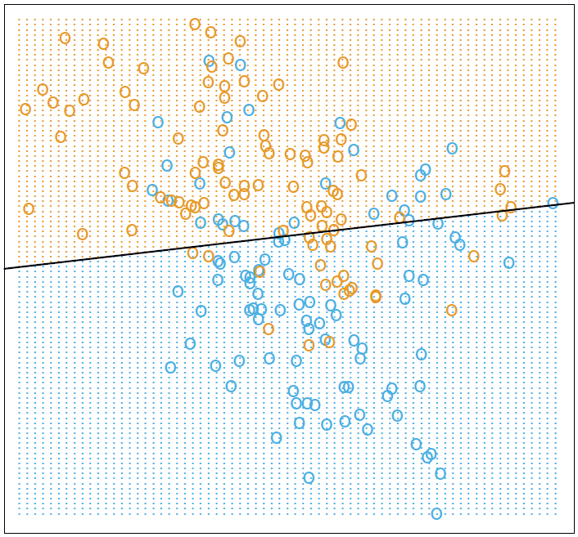
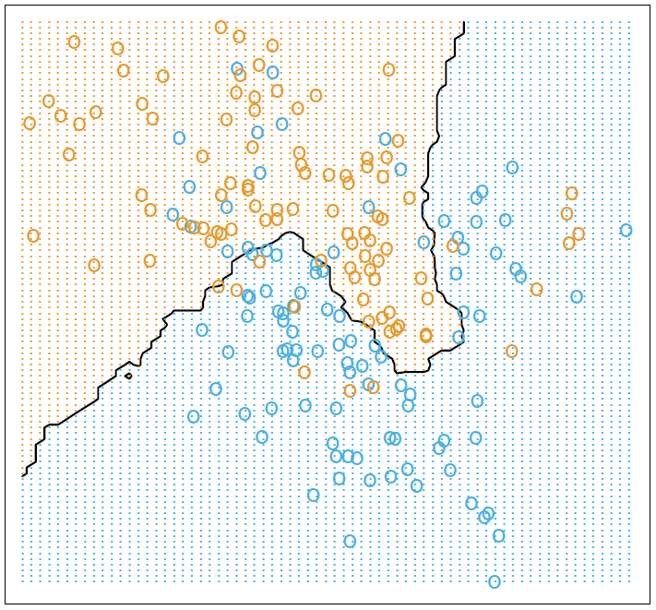
Data Mining Example
Assume that we collect weight and height data of male and female subjects.
We will use this data as training data to devise an approach to predict whether a subject is male or female given only their weight and height.
Weight
Weight
Height
Height
Two different approaches were used.
These provide a decision boundary (line) between males and females

Slide 13
Data Attributes
Data objects are composed of attributes (for the previous example, the data objects were people and the attributes are height and weight)
There are two basic types of attributes:
  Qualitative (eg. color, shape, ranking)
  Quantitative (eg. length in meters, temperature in Celsius)
There are subtypes of basic types that will be subsequently described
On many occasions the algorithm that you use to analyze the data will depend on the attribute type

Slide 14
Qualitative Attribute Types
Nominal (existing by name):
  hair color ∈ {black, brown, blond, red, gray}
  marital status ∈{single, married, divorced}
Binary:
  smoker ∈ {yes, no}
  medical test result ∈ {positive, negative}
Ordinal (ordered):
  drink size ∈ {small, medium, large}
  effectiveness of Instruction∈ {0, 1, 2, 3, 4, 5}

Slide 15
Quantitative Attribute Types
Interval-scaled (no zero (absence of quantity)):
  temperature ∈ R
  latitude ∈{-90⁰ ≤ latitude ≤ 90⁰}
Ratio-scaled (true zero point):
  length ∈ R
  weight ∈ R

Slide 16
Representing Data
Data is commonly represented in the form of a matrix.
When mathematical operations and algorithms are performed on the data, they typically operate on this matrix.

Slide 17
Data Matrix Example
Consider the following data collected about some subjects:
Age | Height (in) | Weight (lb) | Income (000 $) | IQ
20 | 70 | 165 | 31 | 120
35 | 72 | 175 | 46 | 115
28 | 68 | 183 | 86 | 135
58 | 73 | 210 | 128 | 128
29 | 65 | 200 | 35 | 90
This provides a 5x5 matrix, with each data element being a row (with 5 dimensions (attributes))

Slide 18
What is Deep Learning?
Deep Learning is NOT an algorithm – it is a paradigm of hierarchical learning.
Generally, the paradigm is modeling information representations in the mammalian brain.
“One of the key findings has been that the neocortex, which is associated with many cognitive abilities, does not explicitly pre-process sensory signals, but rather allows them to propagate through a complex hierarchy of modules that, over time, learn to represent observations based on the regularities they exhibit”

Slide 19
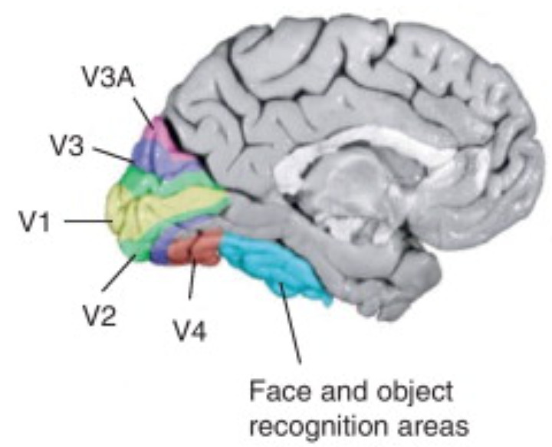
Example – the human visual system
Multi-layered
  Primary visual cortex (v1) – spatial information - spatial frequencies and orientations (also color), Secondary visual cortex (V2) – visual association
  Visual area V3 – coherent motion of large patterns
  Visual area V4 – tuned for object features of medium complexity
  Middle temporal visual area (V5) – perception of motion
  FFA (fusiform face area)

Slide 20
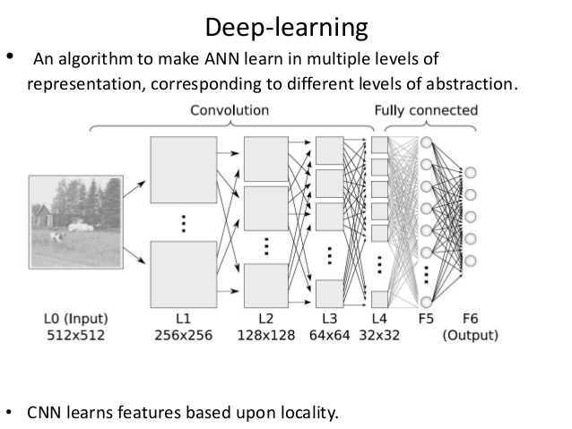
Typical Deep Learning Structure

